Slide 1
AI Training Room Recommendation System

Slide 2

Hello!
I am Dennis
I am here to present machine learning methods trial for new recommender system.
You can find me at: dennis@aitrainingroom

Slide 3
Presentation Agenda
Introduction
Exploratory Data Analysis
Recommender Systems Models
Conclusion

Slide 4
1. Introduction
Project Background:
Explore and compare various maching learning models for course recommender system

Slide 5
1. Introduction
Problem Statement:
Learners need to be able to get suitable course recommendations that fit in their interests
Hypothesis:
A model that approximates the target function and performs mappings of inputs to output

Slide 6

2. Data Analysis
Interesting findings on courses:
Word Cloud
Courses by count
User ratings count
Top 20 courses

Slide 7
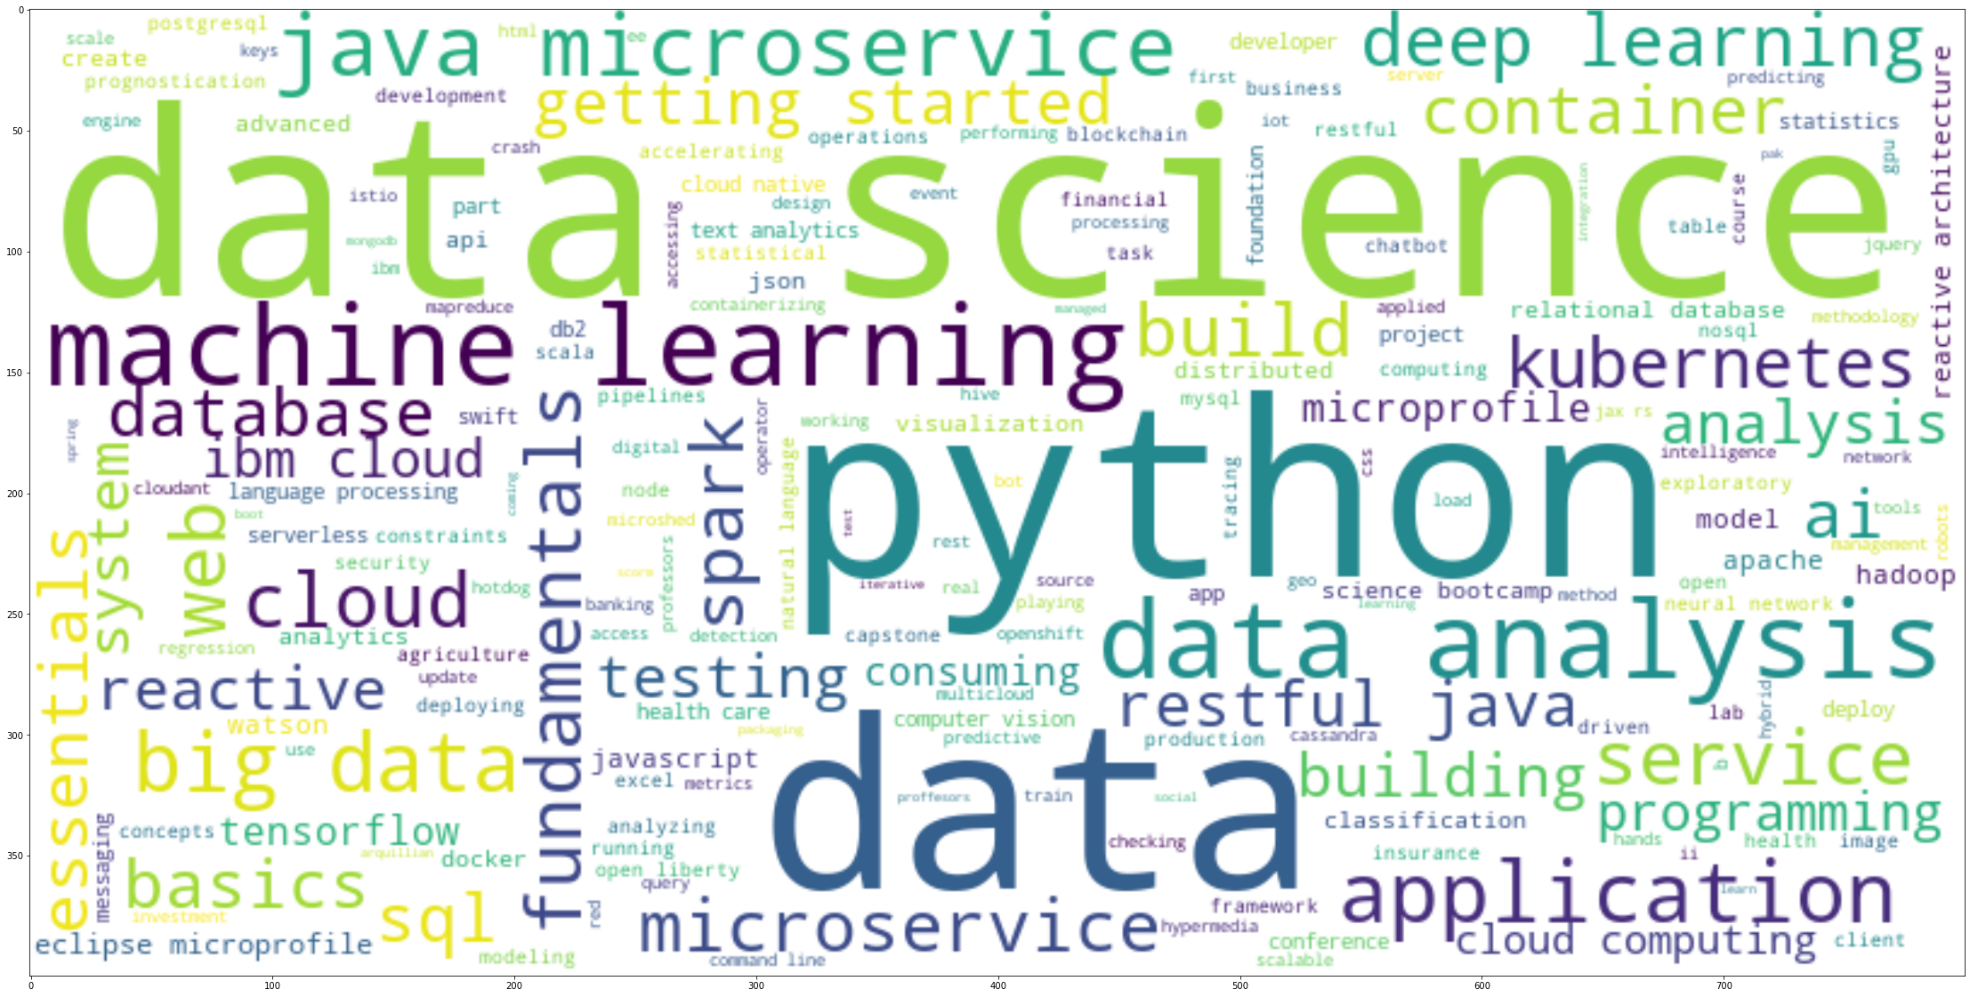

Slide 8
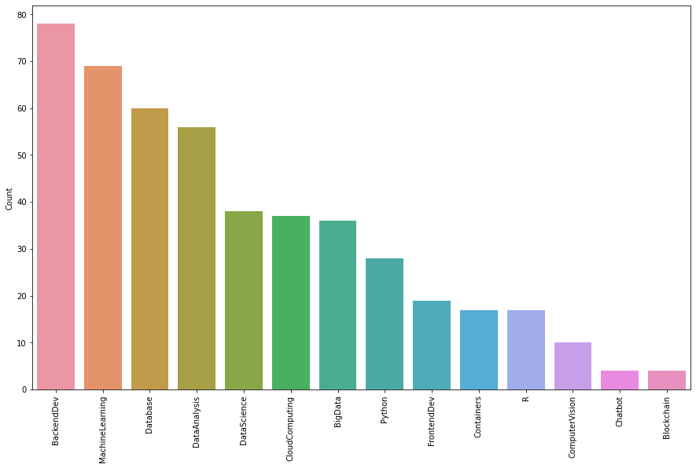

Slide 9
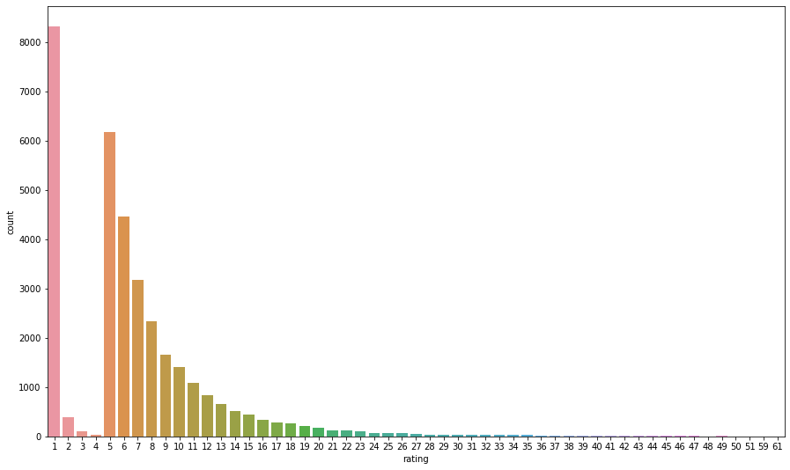

Slide 10
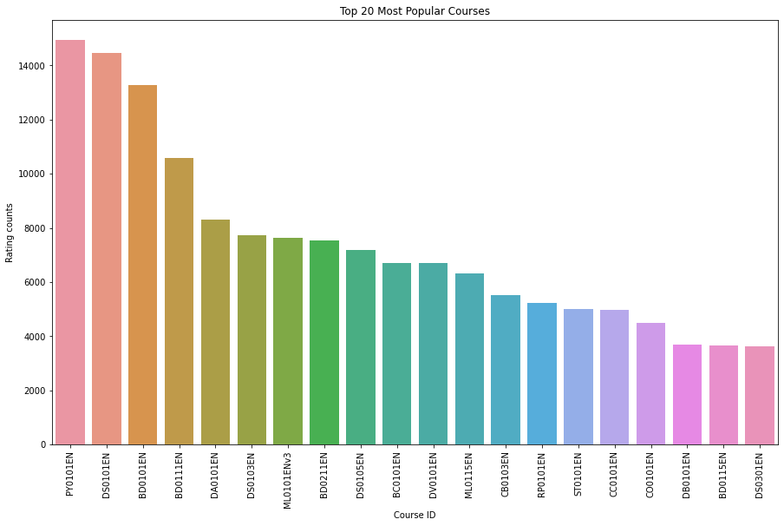

Slide 11
3. Recommender Systems Models
Content-based recommender system based on user profiles:
Create user profiles
Score is calculated
Set a threshold
Advised to limit to maximum 20 results

Slide 12
3. Recommender Systems Models
Content-based recommender system based on course similarity:
Create course similarity matrix
Extract keywords using NLP methods
Calculate indexes and compare scores
Set similarity threshold

Slide 13
3. Recommender Systems Models
Content-based recommender system based on user profile clustering:
User profiles are grouped by similarity
Apply K-Means or PCA algorithms
Recommends the unselected courses from the popular course lists

Slide 14
3. Recommender Systems Models
Collaborative Filtering Based Recommender System using KNN:
Create user-item interactivity matrix
Compute similarity between users/items
Simple but memory intensive

Slide 15
3. Recommender Systems Models
Collaborative Filtering Based Recommender System using NMF:
Solve big matrix issues
Use Surprise Python library

Slide 16
3. Recommender Systems Models
Collaborative Filtering Based Recommender System using NMF:
Solve big matrix issues
Use Surprise Python library

Slide 17
3. Recommender Systems Models
Rating Prediction Based On Neural Network Embedding:
Extract the user and item latent features
Can be used to predict user ratings

Slide 18
3. Recommender Systems Models
Rating Prediction Based On Regression and Classification:
Embedding are inputs and ratings are output
Depending on the model, several metrics are used to assess the model performance

Slide 19
4. Conclusion
If content (words) too many, content based will be taxing on time and high system requirements
Personalized content will be still challenging to unknown user who have unusual taste
Items that has no rating does pose a challenge

Slide 20
Thanks!
Any questions?
You can find me at:
dennis@aitrainingroom

Slide 21
Credits
Special thanks to all the people who made and released these awesome resources for free:
Presentation template by SlidesCarnival
Photographs by Unsplash

